Slide 1

Statistics Data for Basketball Teams
By Basketball Nerds

Slide 2
Project Team Members
Team Lead:
Mr. Alexander Lorin
Senior Developers:
Mr. Ra Ish Andrews
Ms. Rajeswari Natchiappan

Slide 3
Scope of the project
Basketball-Nerds
The team extracted the data from the api, cleaned it by changing column names, ridding columns and creating DataFrames. We then created a connection to PostgreSQL and loaded DataFrames. Scripted queries to match out tables and boom the data was loaded directly to the data base. No need for you to go through all the trouble. In out data file, we've included CSVs and our SQL queries.

Slide 4
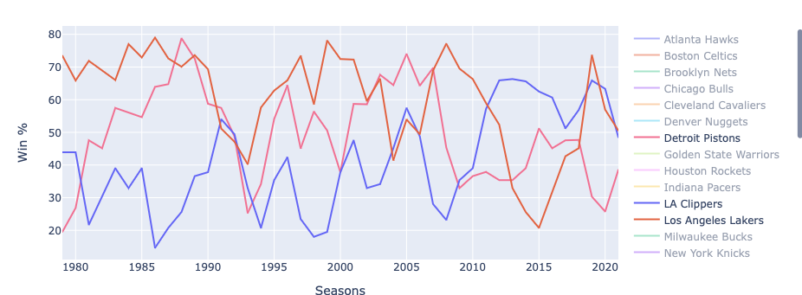
Game Stats based on the Seasons

Slide 5
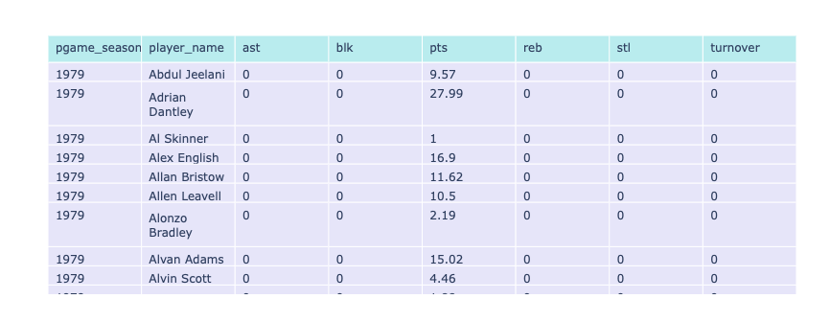
Players Analytics (Data Chart)

Slide 6
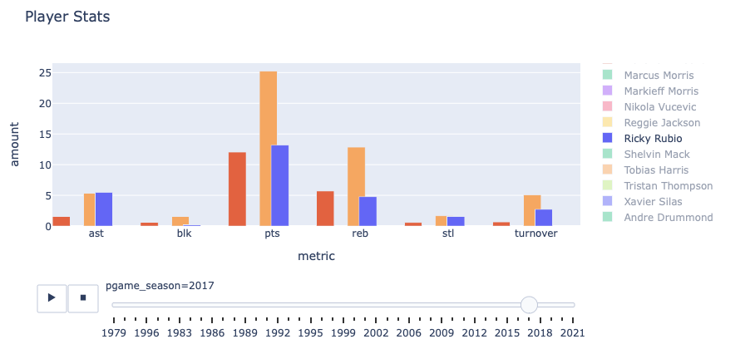
Players Analytics (Player Stats)

Slide 7
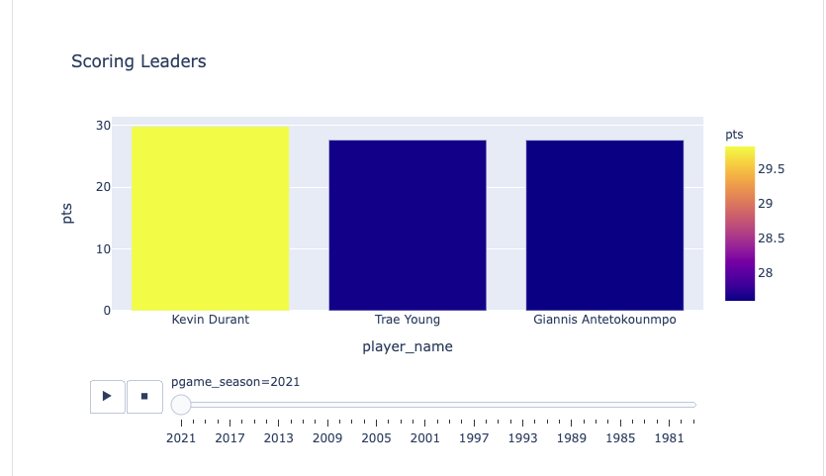
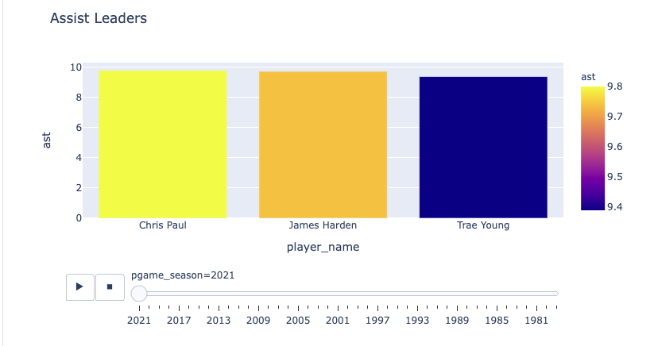
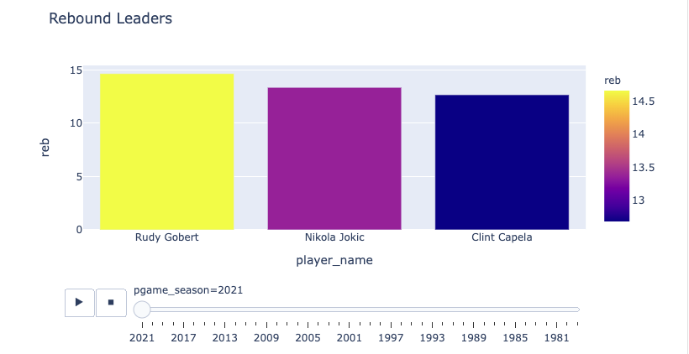
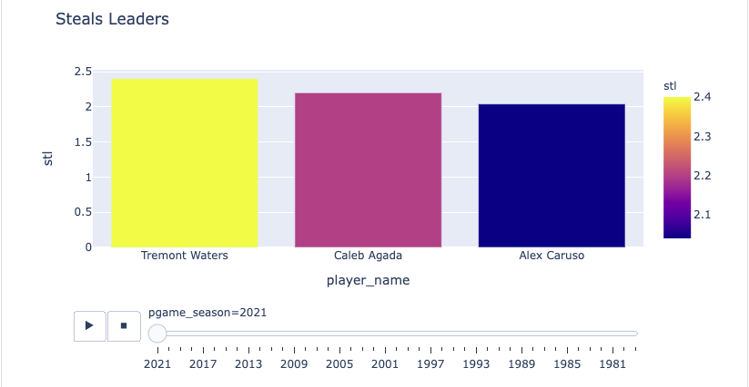
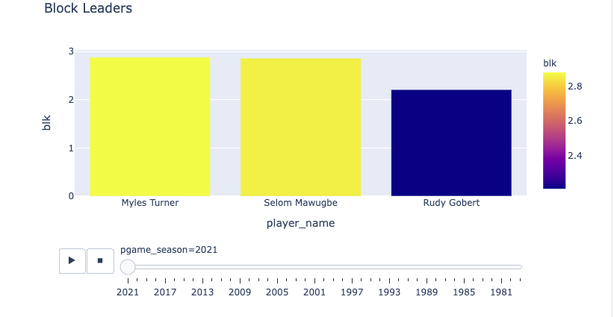
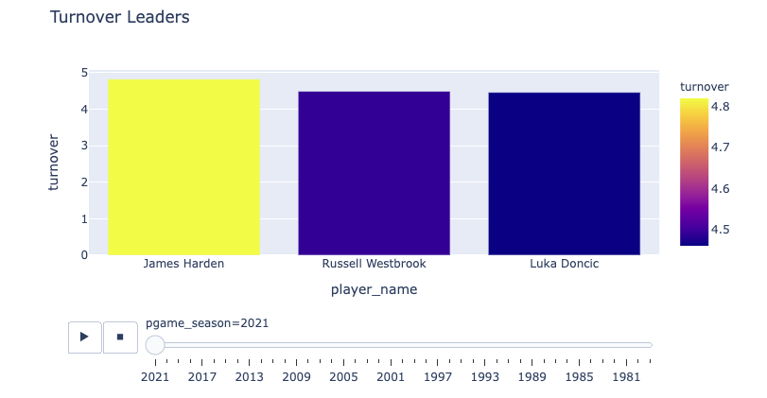
Season Leaders

Slide 8
Tools used
Back end
Python
Pandas
Plotly
postgresSQL
Python Flask
API - https://rapidapi.com/theapiguy/api/free-nba
Dash
Front end
Javascript
CSS
Cloudflare
Bootstrap
AOS

